Slide 1
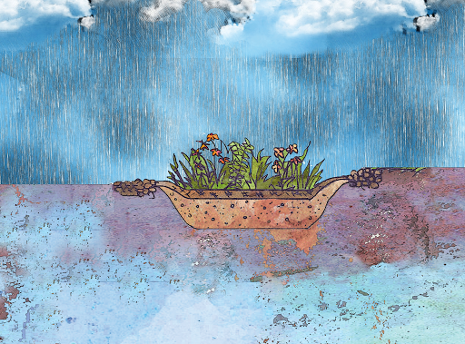



What is a rain garden?
Notes:
This presentation is designed to introduce the importance of rain gardens and explain how rain gardens function. Notes are included for every slide to allow anyone to present the material. If following the script, this presentation is approximately 5-7 minutes long.
Begin script:
This presentation is brought to you by Jefferson County Marine Resources Committee, Washington State University Extension Jefferson County, and the Northwest Straits Foundation.
Today we are going to learn about the important function of rain gardens in our community.

Slide 2
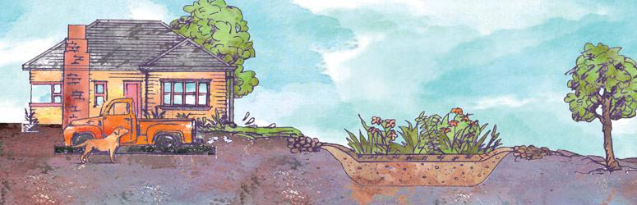
A rain garden is a specialized garden designed to treat stormwater runoff
Notes:
A rain garden is a specialized garden designed to treat stormwater runoff. Rain gardens are designed to be a beautiful amenity in your landscape and can be sized to fit almost any space. Rain gardens are very simple tools that capture and filter polluted stormwater runoff to protect our local waterways.

Slide 3
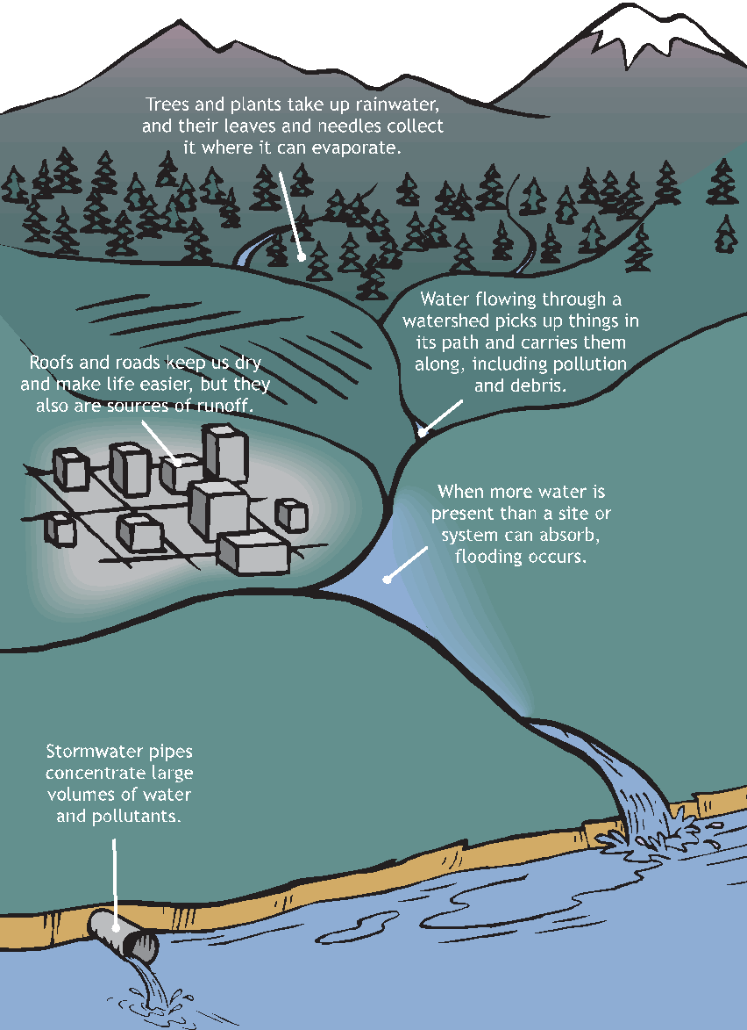
In a watershed, there are many different sources and land uses that contribute to stormwater runoff
Source: Ecology 2017
Notes:
In a watershed like the one you see here, there are many different sources and land uses that contribute to stormwater runoff. In a natural forest, most of the rainwater is absorbed by trees and soils and added to the underground water supply. However, in developed, or urban, landscapes, most of the rainwater is not absorbed. Instead, rainwater is mobilized by impervious surfaces such as roads, roofs, parking lots, and compact soils, and collected by stormwater drains that lead to nearby lakes, rivers, and marine waters. This mobilized rain water is called stormwater runoff. Runoff collects from urban, suburban, and agricultural areas, and transport pollution and debris into our waterways.
*Note: Point to the figure as you talk. The script highlights the forest, city, stormwater pipe, and the path of runoff through different types of land uses.

Slide 4
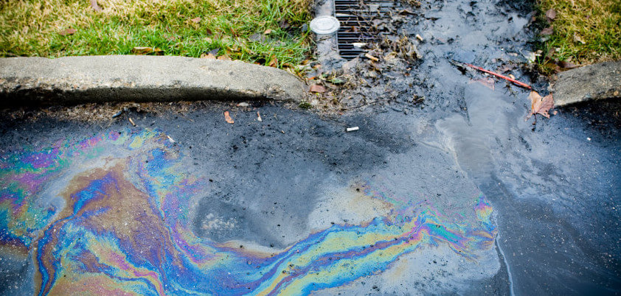
Stormwater runoff is considered the #1 source of toxic pollution to the Salish Sea
Photo credit: City of Ashland
Notes:
In the Salish Sea, stormwater runoff is recognized as the #1 source of toxic pollution. As stormwater travels through the watershed, it mobilizes the large mixture of contaminants and debris found on the surface. This often includes motor oils, heavy metals, pesticides, bacteria, and trash. Stormwater runoff is known to negatively affect salmon and other aquatic organisms, in addition to posing a health risk to humans.

Slide 5
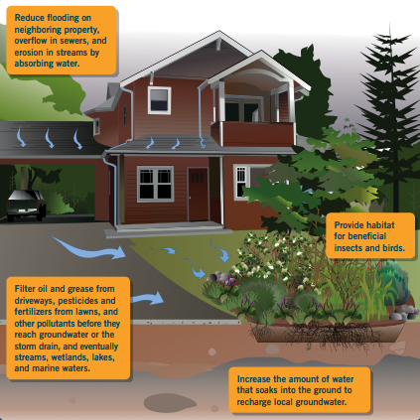
The benefits of rain gardens
1. Reduce flow and flooding
3. Provide habitat
2. Filter contaminants before they pollute waterways
4. Recharge groundwater
Source: Rain Garden Handbook 2013
Notes:
Rain gardens are designed to treat both the quantity and quality of stormwater runoff. First, rain gardens reduce flooding on neighboring property, overflow in sewers, and erosion in streams by absorbing excess water. Through specialized soils, rain gardens can filter oil and grease from driveways, pesticides and fertilizers from lawns, and other pollutions before they reach the groundwater or the storm drain, and eventually end up in streams, wetlands, lakes, and marine waters. Rain gardens also provide habitat for beneficial insects and birds. And lastly, rain gardens increase the amount of water that soaks into the ground to recharge local groundwater.

Slide 6
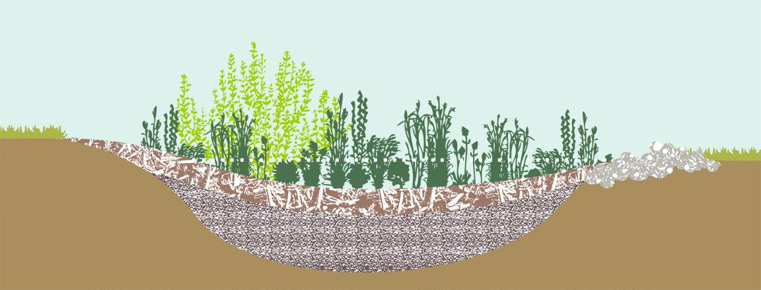
The anatomy of a rain garden
Graphic by Stacey Gianas, Stewardship Partners
Notes:
To understand how a rain garden works, we are going to walk you through the anatomy and construction of a rain garden.

Slide 7

Excavate
Graphic by Stacey Gianas, Stewardship Partners
Notes:
To build a rain garden, the first step is excavation. Rain gardens require a specific depth to allow adequate draining so a small amount of soil, usually 18-24” needs to be excavated.
‹#›

Slide 8
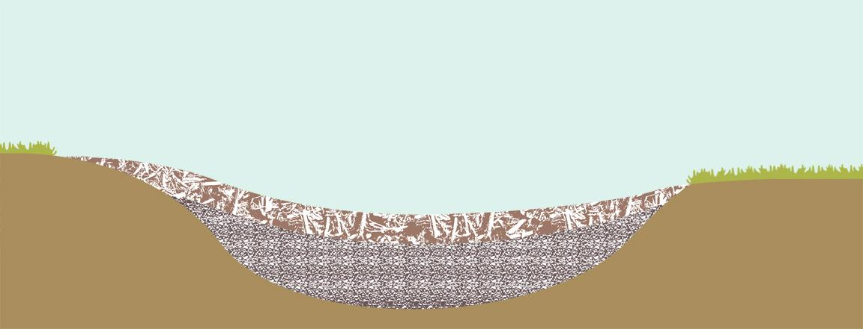
Add soil mix and mulch layer
2” – 3” mulch
12” – 14”
soil mix
Graphic by Stacey Gianas, Stewardship Partners
Notes:
Next, special soil mixes that allow water to soak in rapidly, treat runoff and support plant growth are added to the rain garden. The soil mix is typically 12-14” deep, contains a 60:40 ratio of sand to compost, and is covered with 2-3” of mulch.
‹#›

Slide 9
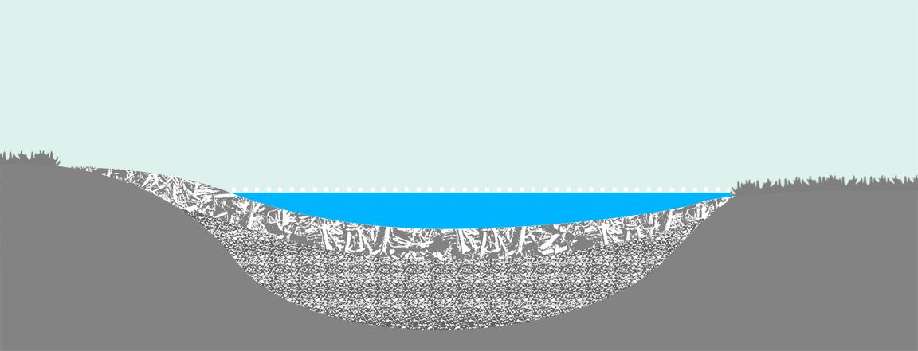
Ponding depth
6” – 12”
ponding depth
Graphic by Stacey Gianas, Stewardship Partners
Notes:
But rain gardens aren’t filled all the way – a shallow depression of about 6-12” is left to accommodate temporary ponding during heavy storms or consecutive rain events. This is called the ponding depth and is a critical part of the rain garden construction.
‹#›

Slide 10
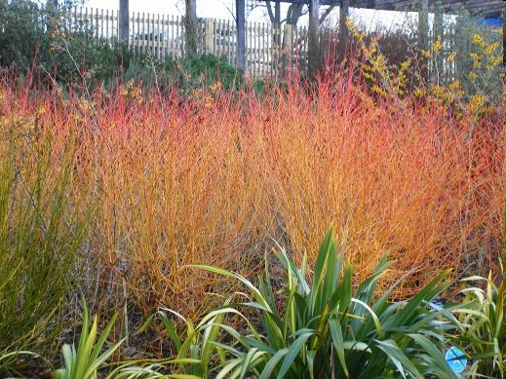
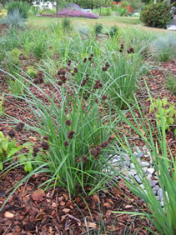
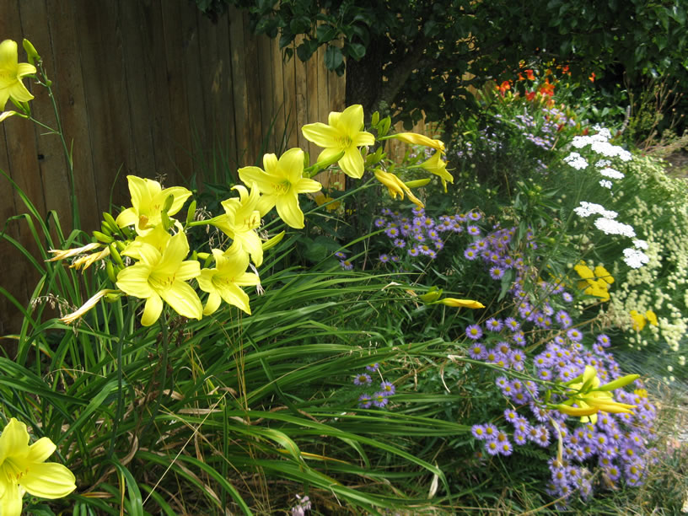
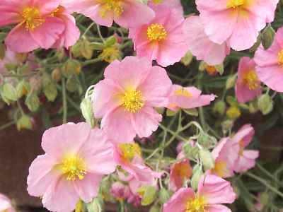
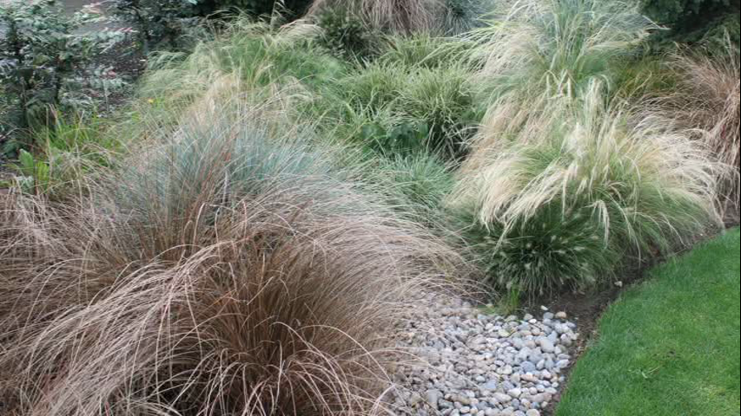
Planting the rain garden
Graphic by Stacey Gianas, Stewardship Partners
Photo credit: Erica Guttman
Notes:
Lastly, plants are added to provide soil structure, soak up and filter water, and add beautiful aesthetics to the rain garden. There are many different types of plants that can be added to a rain garden. Only a few of them are shown here.

Slide 11
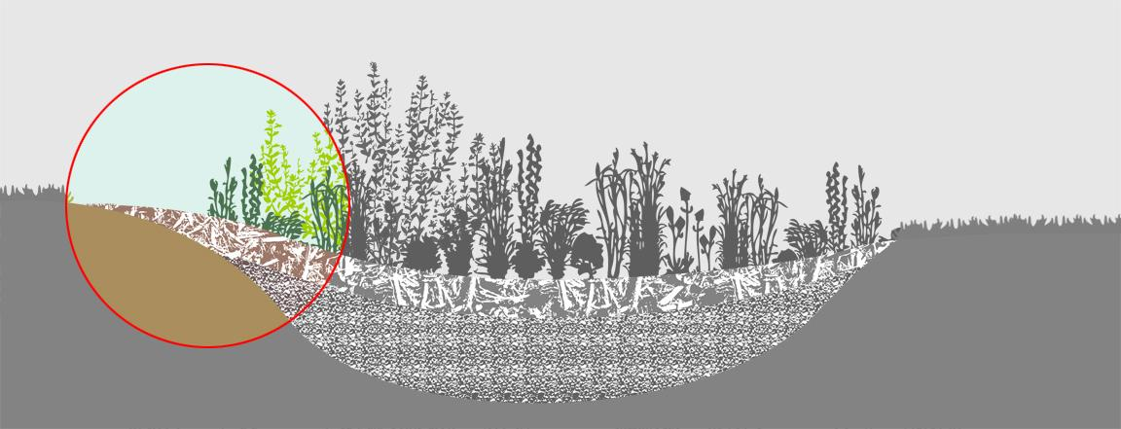
Stormwater inflow
Graphic by Stacey Gianas, Stewardship Partners
Notes:
Once the rain garden is constructed, untreated stormwater can safely flow into the rain garden via a pipe or swale.
‹#›

Slide 12
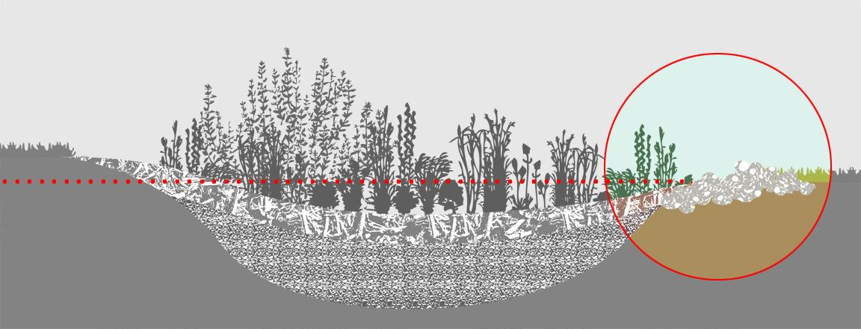
Stormwater overflow
Graphic by Stacey Gianas, Stewardship Partners
Notes:
Stormwater is slowly treated through the soil mix and absorbed into the ground. If there is more stormwater than the garden can handle, such as in large storm events, stormwater can safely “overflow” out of the garden.
‹#›

Slide 13
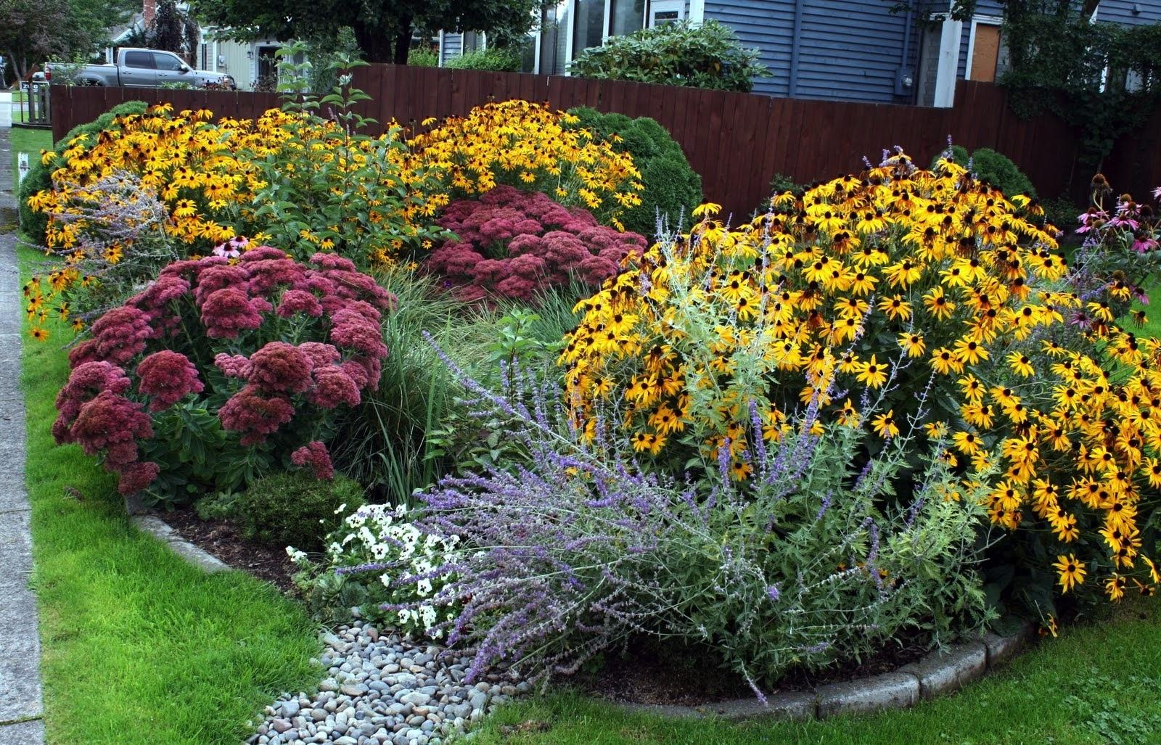
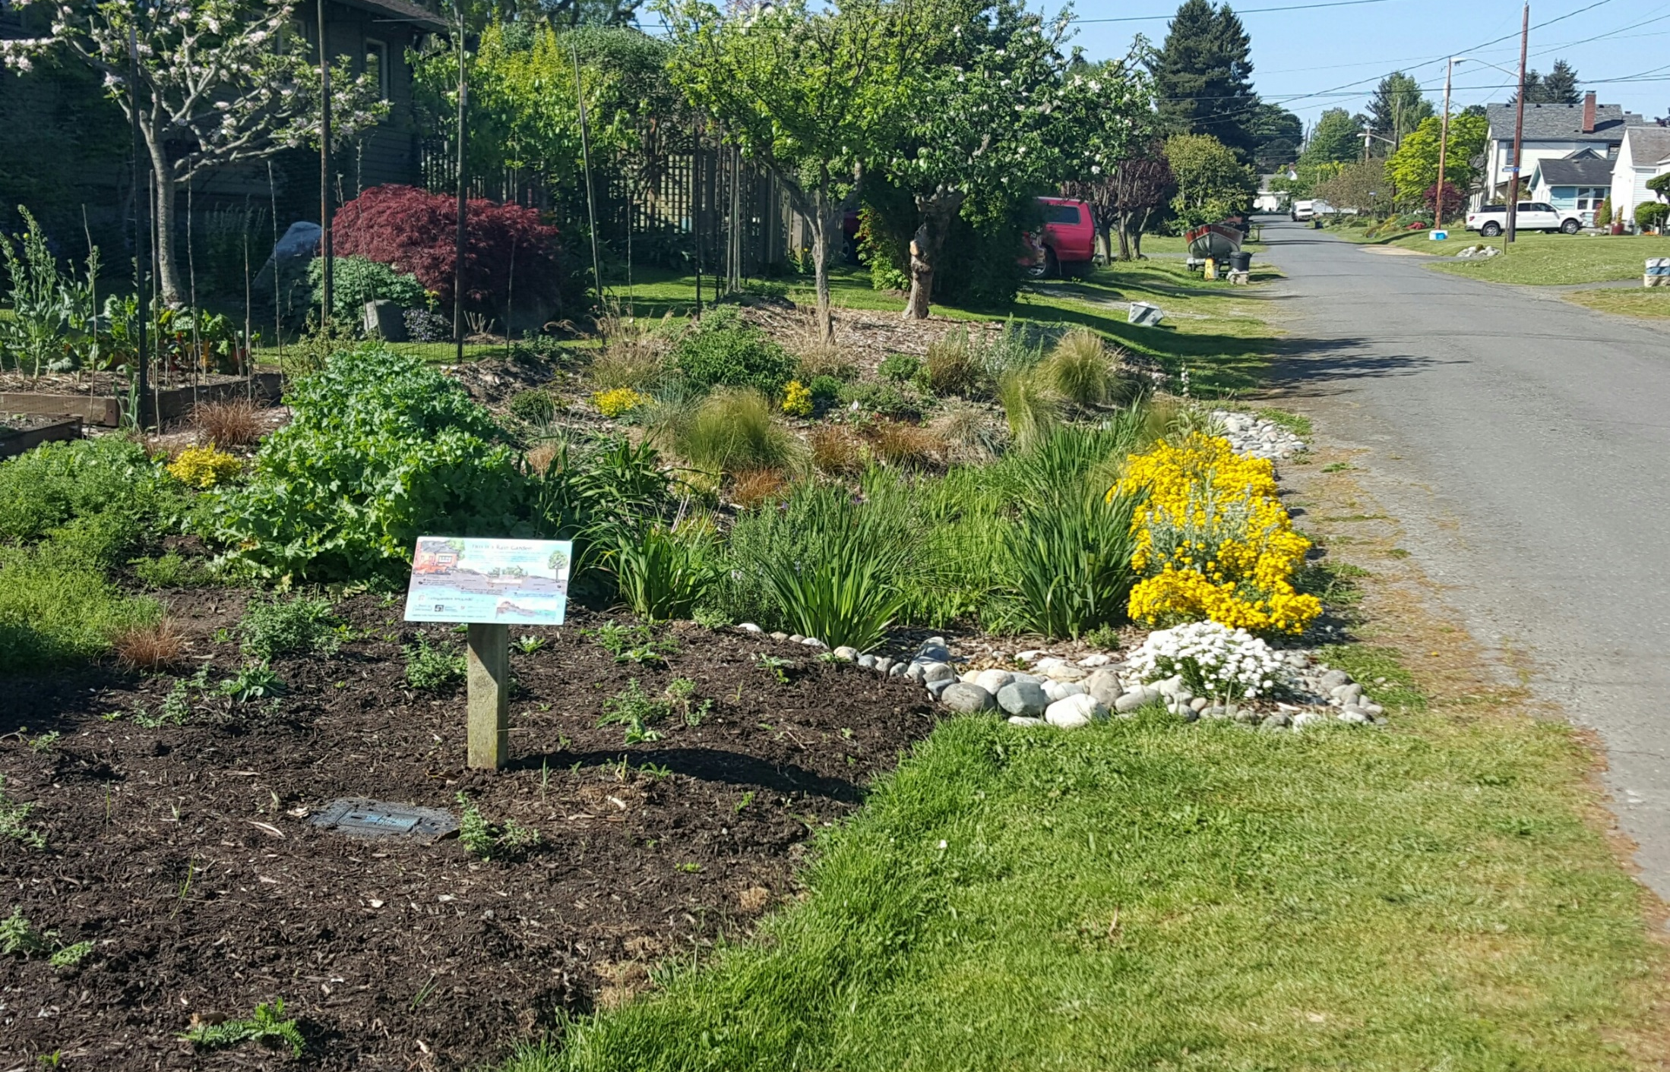
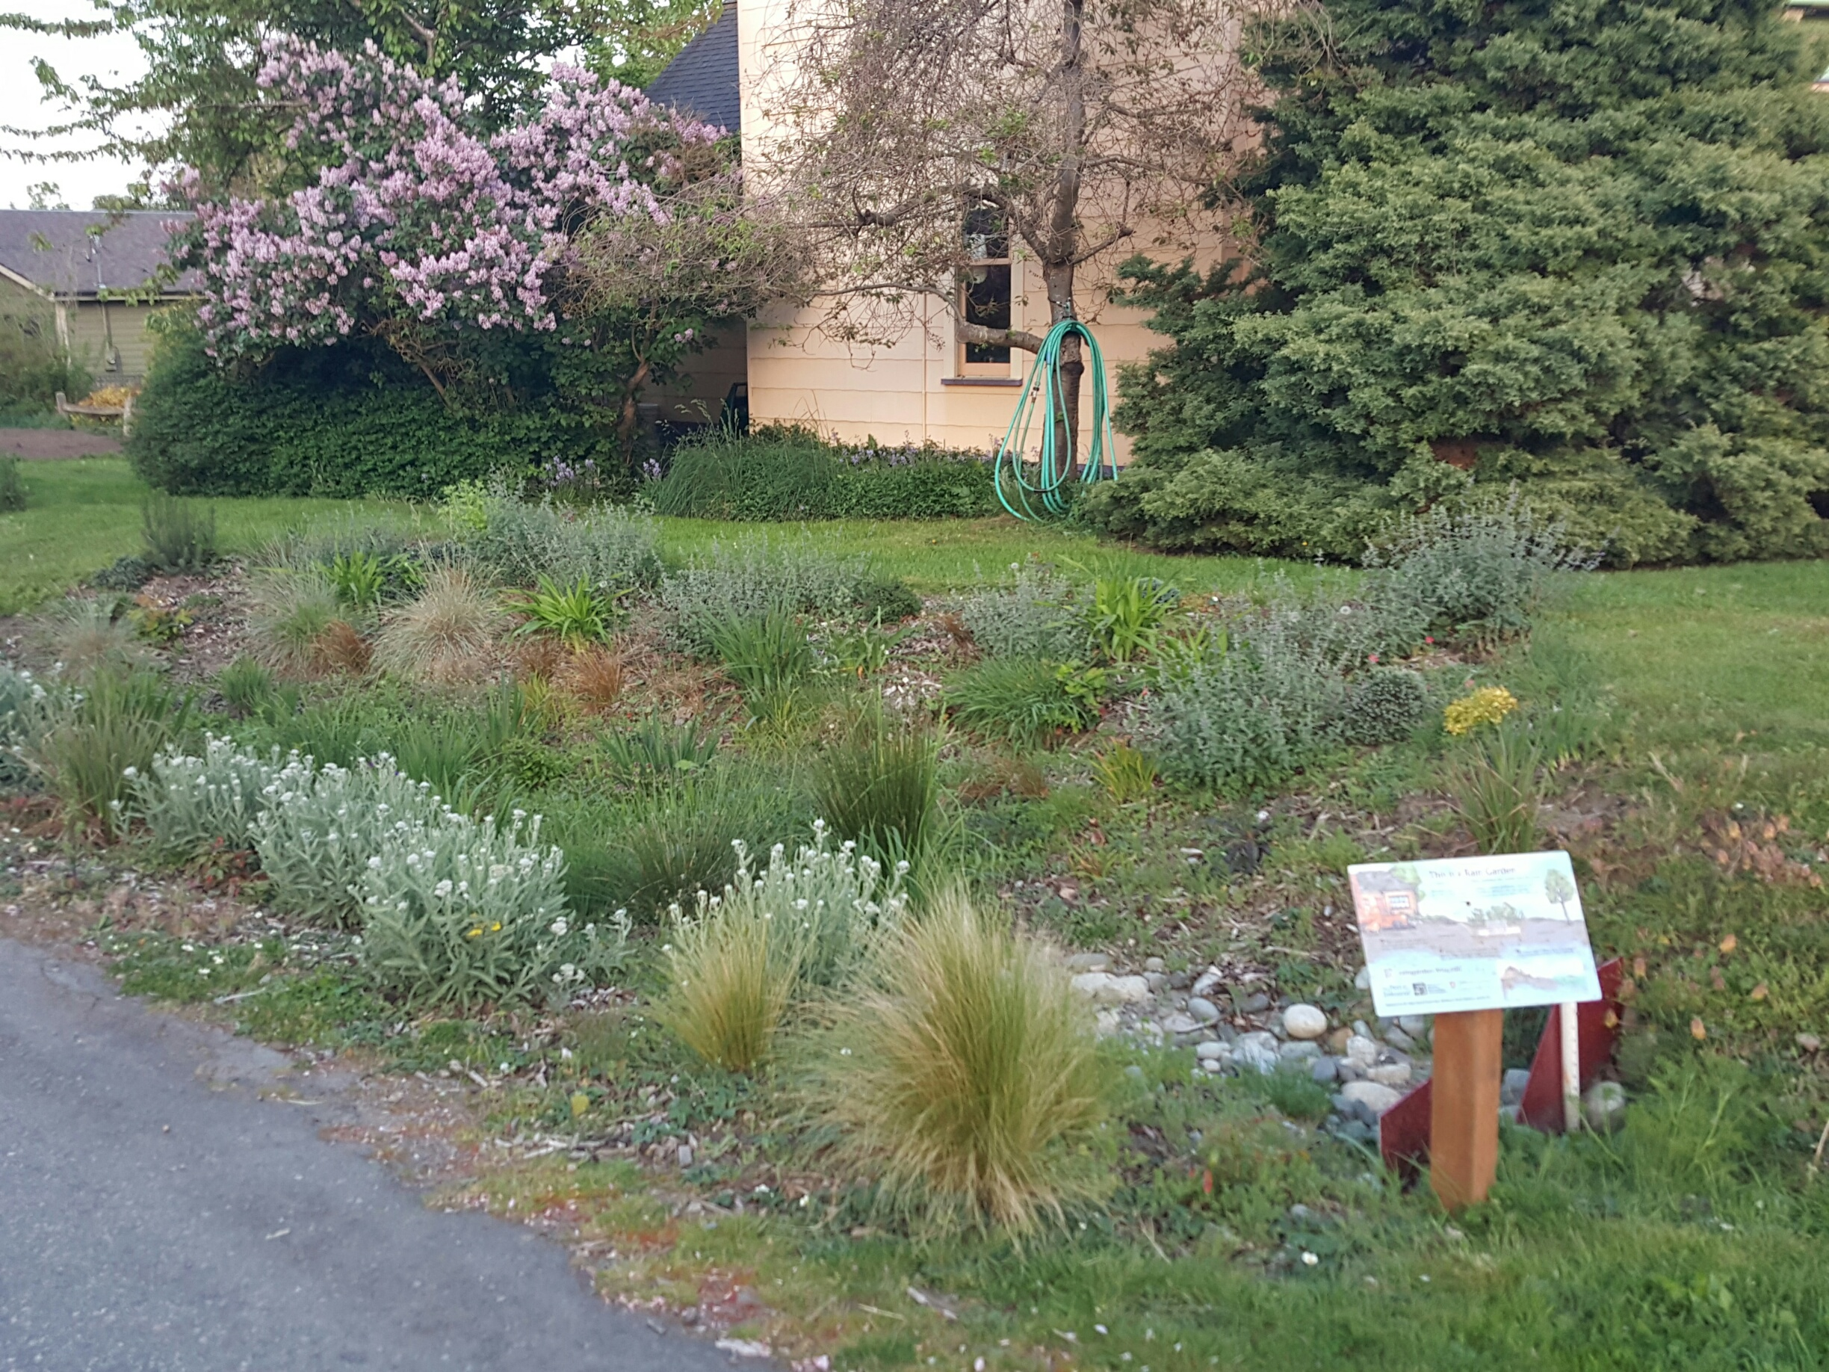
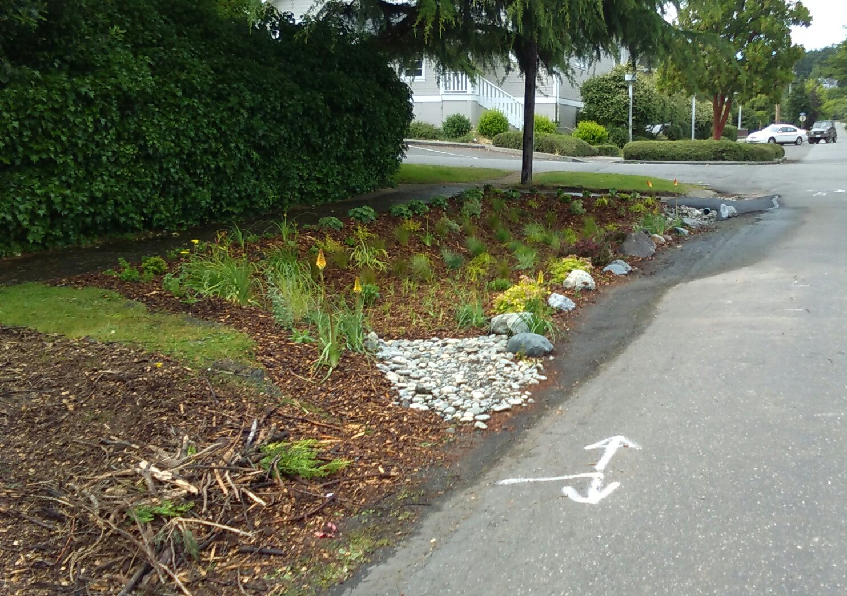
Local rain gardens
Notes:
Here are some local rain gardens. As you can see, they vary in location and aesthetics, but all of them are helping treat toxic stormwater water with simple soil mixes and plants.

Slide 14
Rain gardens are beautiful, inexpensive and low-maintenance gardens with many environmental benefits.
Notes:
In conclusion, rain gardens are beautiful, inexpensive and low maintenance gardens with many environmental benefits.

Slide 15
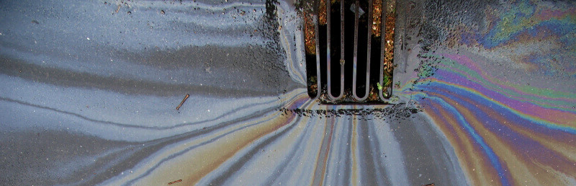
Rain gardens intercept, treat and infiltrate stormwater at the source, before it becomes runoff.
Photo credit: CDOT
Notes:
Rain gardens intercept, treat, and infiltrate stormwater at the source before it becomes runoff and pollutes our waterways. Rain gardens are a useful tool to help us protect the Salish Sea from toxic stormwater pollution.
End script.

Slide 16
For more information, visit:
http://raingarden.wsu.edu
http://www.12000raingardens.org/
Or watch the following video:
http://www.washingtonnature.org/cities/solvingstormwater
Notes:
*Note: Solving Stormwater is a video (~6 minutes) made by the Nature Conservancy on the effects of stormwater runoff to Pacific salmon and how low impact development technology can help prevent the effects.

Slide 17
References
Hinman, C. 2013. Rain Garden Handbook for Western Washington: A guide for design, maintenance, and installation.
Howard, S. 2017. Environment Education Guide: Protecting Washington’s waters from stormwater pollution. Department of Ecology Report.

